Slide 1
REAL TIME ATTENDANCE TRACKING OF STUDENTS AND TEACHERS IN SCHOOLS
BY:
TEAM PEDAGOGICS
ANEESHA GUJRAL
LALIT MISHRA
RAMANDEEP SINGH
PRIYANKA MODI

Slide 2
INTRODUCTION:
We all are quite familiar about attendance tracking systems that are used by schools these days for attendance management in urban schools.
These systems are getting real results as they help in reducing absentees and tardiness in private schools.
Similarly our real time attendance tracking system will impact the rural education in many ways.

Slide 3
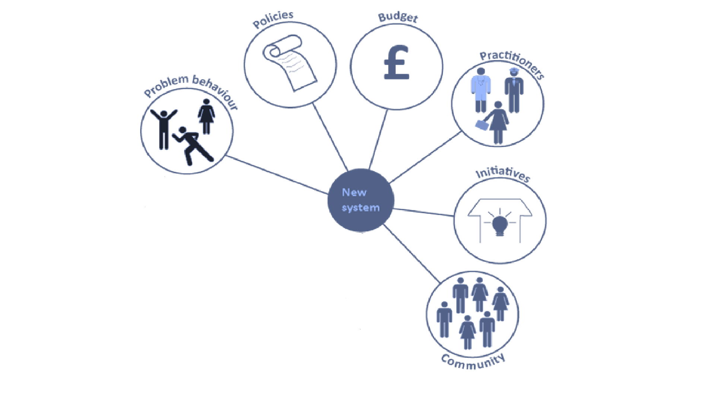
GOVERNMENT SCHOOLS
Attendance Tracking
P&G, ITC
STUDENTS, TEACHERS & PARENTS

Slide 4
IDEA!!
Tracking the attendance of students and teachers via FACE DETECTION to help the government increase the attendance

Slide 5
WORKING OF THE PROTOTYPE:
Developed for deploying an easy and a secure way of taking down attendance.
It stores the image by mapping it into a face coordinate structure.
Next time whenever the registered person enters the premises the system recognizes the person and marks his attendance.
The software first captures an image of all the authorized persons and verifies the information into database.

Slide 6
Student
VIDEO
Take snapshot
IMAGE
CLEAR IMAGE
Face detection
Face segmentation
IMAGE
Registration system
Student attendance
FACE IMAGE
ATTENDANCE INFORMATION
STUDENT ID
STORED IMAGE
Record attendance
Face recognition
Face image
ATTENDANCE
Generate report
STUDENT ATTENDANCE REPORT (WORKING)

Slide 7
ADVANTAGES & DISADVANTAGES:
ADVANTAGES:
Regular monitoring of student, teachers as to regulate their presence, resulting increase in productivity and efficiency in education system.
Reduce paper work.
Easy time management and tracking.
Fairly applies and enforces attendance policies.
DISADVANTAGES:
Errors in Software, Database and operating systems can cause a serious breakdown.
The system don’t recognize properly in poor light so may give false results.
It can only detect face from a limited distance.

Slide 8
OPPORTUNITIES:
REDUCE ABSENTEESIM
REMOVE TARDINESS
RELIABLE MONITORING

Slide 9
SWOT ANALYSIS
Time saving, cost-effective, automatic recording, reduce paper work
Fairly applies and enforces the attendance policies, provides historical record keeping, and reporting of student and employee attendance habbits.
Entrance of the substitutes with higher configuration and low cost.
Software error and hardware error will lead to a break-down
S
W
O
T

Slide 10
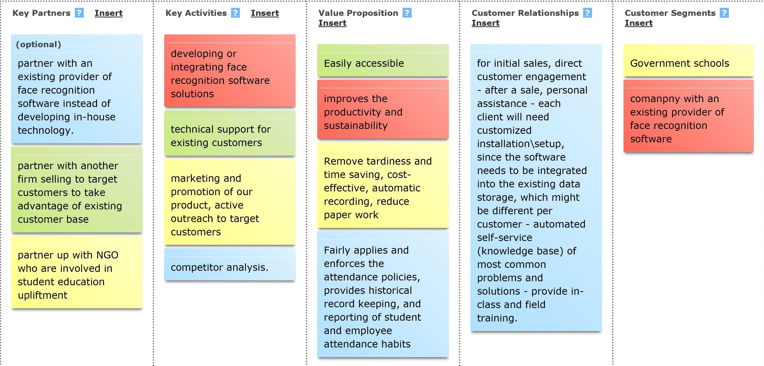
BUSINESS CANVAS MODEL:

Slide 11
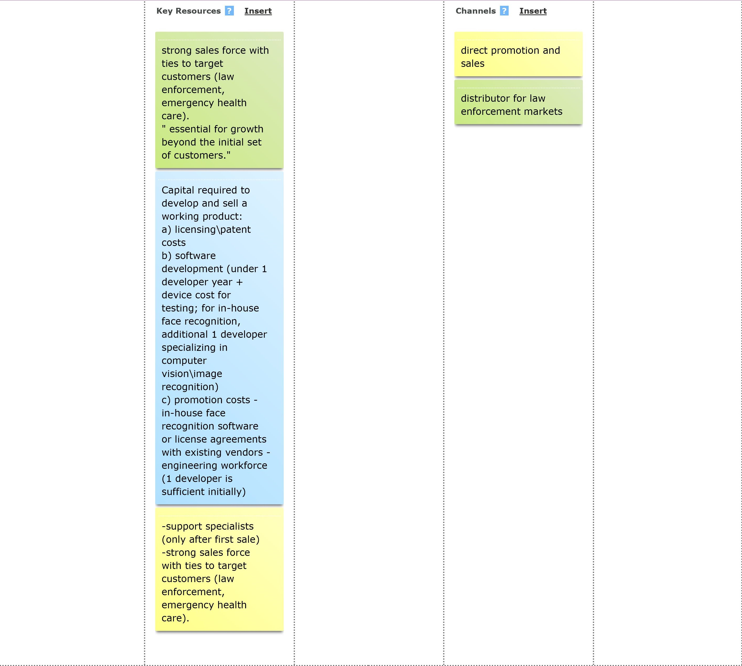

Slide 12
